Slide 1

Elegant Tests
Notes:
Welcome to Elegant Tests.

Slide 2
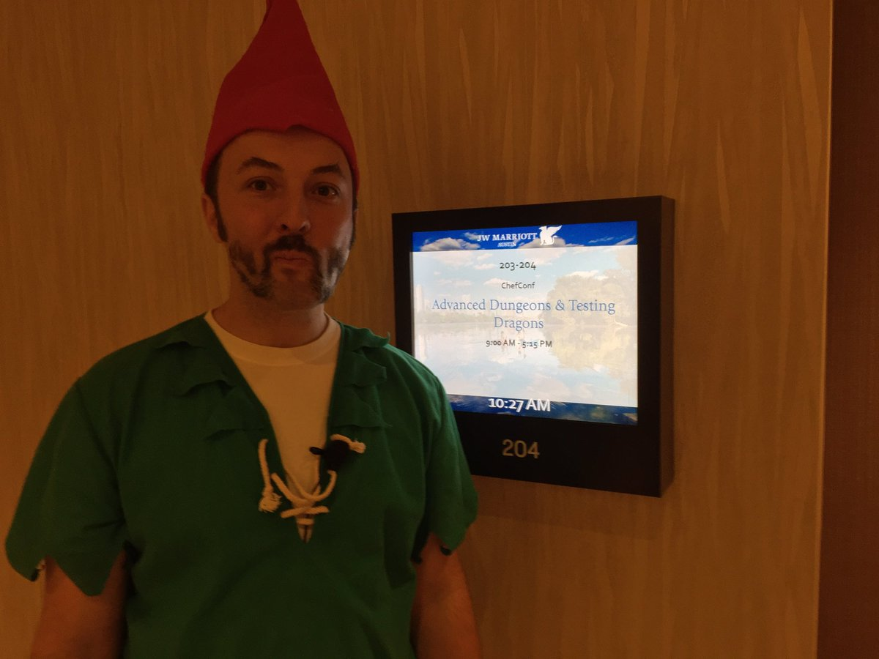
Instructor Name
Title
Contact information
Work History
Witty Quotes
Details you want to share
Notes:
Before we start let me introduce myself.

Slide 3



Who I Think You Are
Chef Cookbook Author
Author and maintain Chef Cookbooks with ChefSpec Tests
Maintainer of a test suite that contains lots of duplication
Interested in furthering your knowledge of Ruby's RSpec
OR
Training
training.chef.io
Chef Essentials
Test-Driven Cookbook Development
chef.io/webinars/?commid=191263
chef.io/webinars/?commid=194483
Notes:
When creating this workshop we spent a lot of time thinking about who you are to help guide us in preparing the best content to assist you and to define the scope of what to share with you.
First and foremost we made the assumption that you are an author or co-author of cookbooks. By that we mean you have edited or created recipes and defined attributes. During your time working with Chef you have written unit tests to help describe the intended purpose of your recipes. Ideally we are talking to some of you that have created a bit of a problem for yourself with how big your test suite has become. And whether or not you have that problem you are interested in learning more about how Ruby's RSpec can increase the elegance of the tests you write.

Slide 4
Introduce Yourselves
Name
Current Role
Previous Roles / Background
Experience with Chef
Conversation Topics (complete these sentences)
The most difficult thing that I've tested was ...
My team and I review code before we commit it to production by ....
Notes:
Before we begin let's take a moment to get to know one another.
Instructor Note: Often times with larger, in-person groups I prefer to have the individuals perform this introduction one-on-one. Having people leave their desks and greet as many people as they can during the time allotted. I often feel this works better as it removes the pressure from the single individual to introduce themselves in a way that is presenting themselves and not actually greeting people. When Online, I create a pre-defined order, announce that order, and then invite a person to speak, thank them when they are done.

Slide 5
Expectations
You will leave this class with the ability to combat redundancy in your tests.
You bring with you your own domain expertise and problems. Chef is a framework for solving those problems. Our job is to teach you how to express solutions to your problems with Chef.
Notes:
The goal of this training is to teach you techniques that will combat the redundancy in your test suite and then extract those helpers into a Ruby gem.
Chef is built on top of Ruby. The testing tools built on top of RSpec. This means you have the power of a programming language at your disposal and we will have to keep a tight focus on the challenges and exercises presented in this content. During and throughout the content we will have discussion where we may have additional time to talk about many different topics but in this interest of time and popular opinion we may need to leave those discussions.
During the introductions you learned about the other individuals here in the course with you. They may have shared similar problems and domains. During the time that we are here respectfully reach out them so that you can continue the conversation, grow each others' knowledge, and become better professionals.

Slide 6
Expectations
Ask Me Anything: It is important that we answer your questions and set you on the path to be able to find more answers.
Break It: If everything works the first time go back and make some changes. Explore! Discovering the boundaries will help you when you continue on your journey.
Notes:
All throughout this training I strongly encourage you to ask questions whenever you do not understand a topic, an acronym, concept, or software. By asking a question you better your learning and often times better the learning of those with you in this training. Asking questions is a sign of curiosity that we want to encourage and foster while we are here together.
This curiosity can also be employed by exploring the boundaries of the tools you are using and the language you are writing. The exercises and the labs we will perform will often lead you through examples that work from the beginning to the end. When you develop solutions it is rare that something works from the start all the way to the end. Errors and issues come up from typos or the incorrect usage of a command of the programming language. When you fall off the path it can often be hard to find your way back. Here, if you find yourself always on the correct path explore what happens when you step off of it, what you see, the error messages you are presented with, the new results you might find.

Slide 7
Group Exercises, Labs, and Discussion
This course is designed to be hands on. You will run lots of commands, write lots of code, and express your understanding.
Group Exercises: All participants and the instructor will work through the content together. The instructor will often lead the way and explain things as we proceed.
Lab: You will be asked to perform the task on your own or in groups.
Discussion: As a group we will talk about the concepts introduced and the work that we have completed.
Notes:
The content of this training has been designed in a way to emphasize this hands-on approach to the content. Together, we will perform exercises together that accomplish an understood objective. After that is done you will often emphasize an activity by performing a lab. The lab is designed to challenge your understanding and retention of the previously accomplished exercises. You can work through this labs on your own or in groups. After completing the labs we will all come together again to review the exercise. Finally, we will end each section with a discussion about the topics that we introduced. These discussions will often ask you to share your opinions, recent experiences, or previous experiences within this domain.

Slide 8
Morning
Afternoon
Introduction
let
shared_examples
def method
shared_context
require
alias_example_group_to
Creating a Ruby gem
Conclusion
Notes:
This is the outline of the events for this workshop. Please take a moment to review this list to ensure that the topics listed here meet your expectations. Take a moment to note which topics are of most interest to you. Also note which topics are not present here on this list. We will discuss your thoughts at the end of the section.

Slide 9
Pre-built Workstation
We will provide for you a workstation with all the tools installed.
Login to the Remote Workstation
Notes:
As I mentioned there is a lot work planned for the day. To ensure we focus on the concepts we introduce and not on troubleshooting systems we are providing you a workstation with the necessary tools installed to get started right away.
Instructor Note: The learners for this workshop can use their own workstations. However, if there are any troubles or concerns it is important to provide them with one to ensure that the time is spent on learning the material and not troubleshooting any installation issues. At the end of the training it is often a good idea to offer your services to help individuals install necessary software or troubleshoot their systems.

Slide 10
Login to the Workstation
> ssh IPADDRESS -l USERNAME
The authenticity of host '54.209.164.144 (54.209.164.144)' can't be established.RSA key fingerprint is SHA256:tKoTsPbn6ER9BLThZqntXTxIYem3zV/iTQWvhLrBIBQ.Are you sure you want to continue connecting (yes/no)? yes
chef@54.209.164.144's password: PASSWORD
chef@ip-172-31-15-97 ~]$
Notes:
I will provide you with the address, username and password of the workstation. With that information you will need to use the SSH tool that you have installed to connect that workstation.
This demonstrates how you might connect to the remote machine using your terminal or command-prompt if you have access to the application ssh. This may be different based on your operating system.

Slide 11
Pre-built Workstation
We will provide for you a workstation with all the tools installed.
Login to the Remote Workstation
Notes:
Now that you are connected to that workstation we have taken care of all the necessary work to get started with the training.

Slide 12
Discussion
What topics are you most interested in learning?
What topics are missing that you want to learn about?
Notes:
Let us end with a discussion about the following topics.
Instructor Note: With large groups I often find it better to have individuals turn to the individuals around them, form groups of whatever size they feel comfortable, and have them take turns asking and answering the questions. When all the groups are done I then open the discussion up to the entire group allowing each group or individuals to share their answers.

Slide 13
Q&A
What questions can we answer for you?
Notes:
Before we continue let us stop for a moment answer any questions that anyone might have at this time.

